Slide 1
PRESIDENT’S REPORT​
Mun Y. Choi​
Board of Curators Meeting​
April 20, 2023​

Slide 2
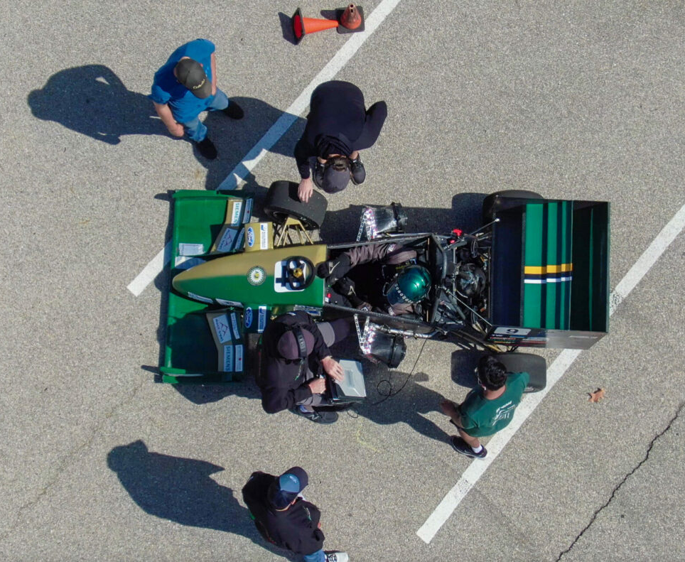
S&T Money Magazine Ranking
Missouri S&T is ranked 5th in the nation and 1st in Missouri according to Money Magazine’s “Best Colleges for Engineering Majors”
#1 | Georgia Institute of Technology
#2 | Massachusetts Institute of Technology
#3 | Colorado School of Mines
#4 | Purdue University
#5 | Missouri University of Science and Technology
#6 | Texas A&M University-College Station
#7 | Princeton University
#8 | Worcester Polytechnic Institute
#9 | University of Illinois at Urbana-Champaign
#10 | New Jersey Institute of Technology

Slide 3
Admissions Update
Freshmen Accepted (with deposits)
Transfer Accepted (with deposits)
4/17/23 | 2021​ | 2022​ | 2023​
MU​ | 4,693 | 5,015 | 5,324 (6%)
UMKC​ | 1,030 | 1,061 | 1,095 (3%)
S&T​ | 1,251 | 1,137 | 1,164 (2%)
UMSL​ | 218 | 325 | 427 (31%)
Total | 7,192 | 7,538 | 8,010 (6%)
4/17/23 | 2021​ | 2022 | 2023
MU​ | 682 | 640 | 627 (-2%)
UMKC​ | 612 | 558 | 573 (3%)
S&T​ | 138 | 134 | 199 (49%)
UMSL​ | 450 | 507 | 554 (9%)
Total | 1,882 | 1,839 | 1,953 (6%)

Slide 4
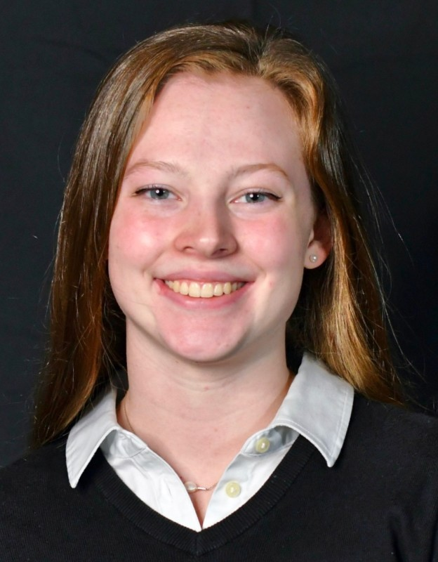
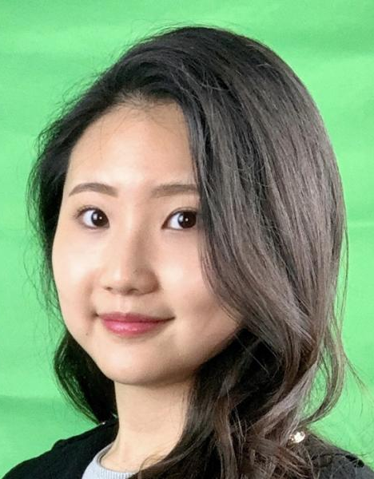
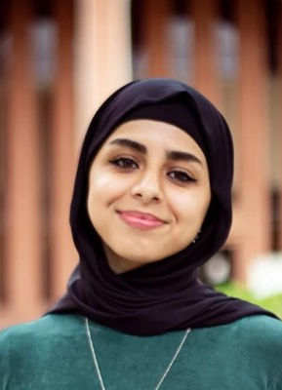
Student Success
Claire Saylor
Optometry
Coleman Goulding
Aerospace Engineering
Named VP of the National American Optometric Student Association
Won the National Space Club Scholarship and Goddard Memorial Keynote Speaker
Lilly Kamlar
Yasmeen Honon
Kristen Barwick, Emma McDougal, Jenny Park and Dylan Fowler
Winners of the U.S. Dept. of State's Gilman Scholarship
2023 Barry Goldwater Scholars to pursue STEM PhD

Slide 5
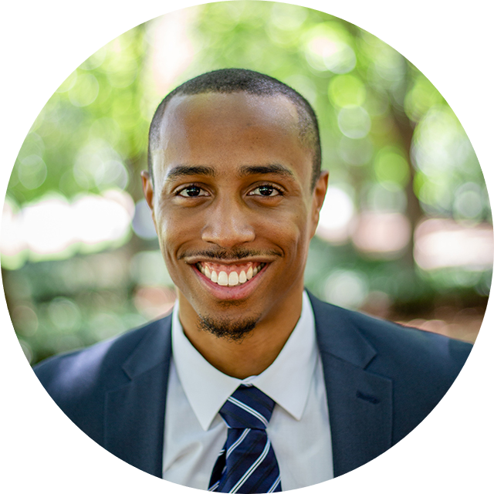
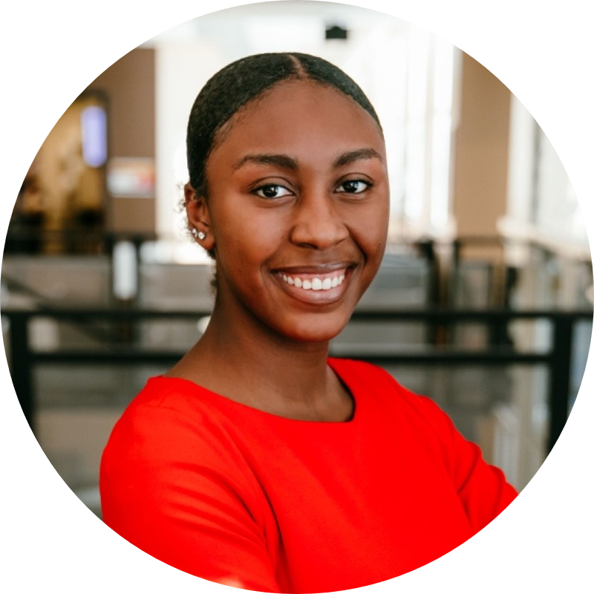
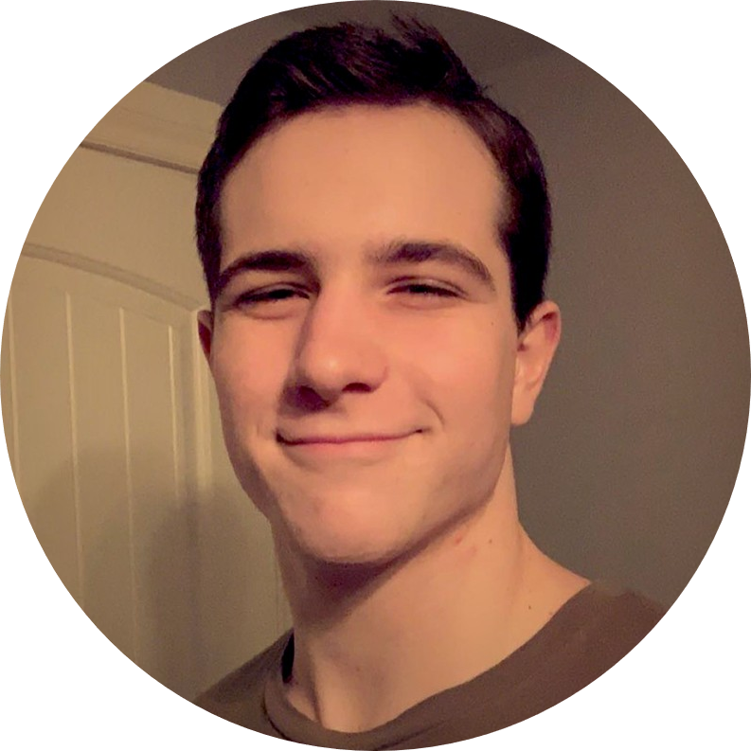
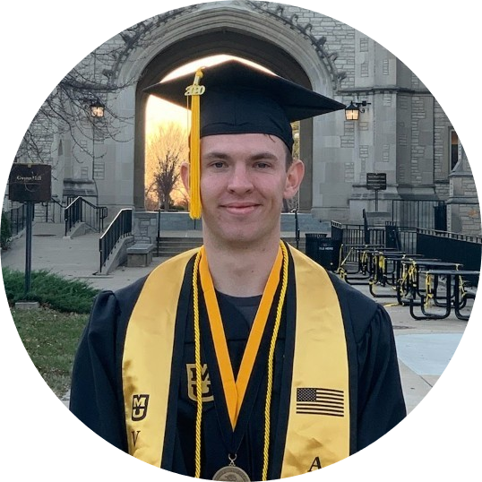
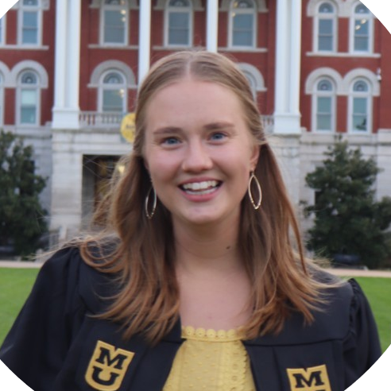
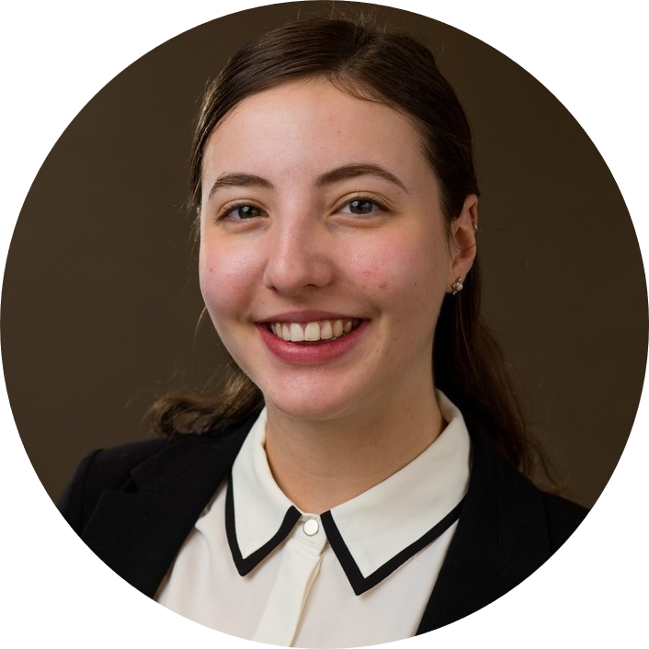
NSF Graduate Research Fellowship Program Winners
Victoria Allen Neurosciences
Bacc. Institution- MU
Joseph Fritsche Biochemistry
Bacc. Institution- MU
James Gamble
Economics
Bacc. Institution- MU
Jasmine Godwin Human Development & Family Science
Current Institution- MU
Lucas Kuehnel Engineering
Bacc. and Current Institution- MU
Daniel Lamm Systems and Molecular Biology
Bacc. Institution- MU
Brooklin Runge Engineering
Bacc. and Current Institution- MU
Chantelle Wimms Ecology
Current Institution- MU
Sadie Brasel Engineering
Bacc. Institution- UMKC

Slide 6
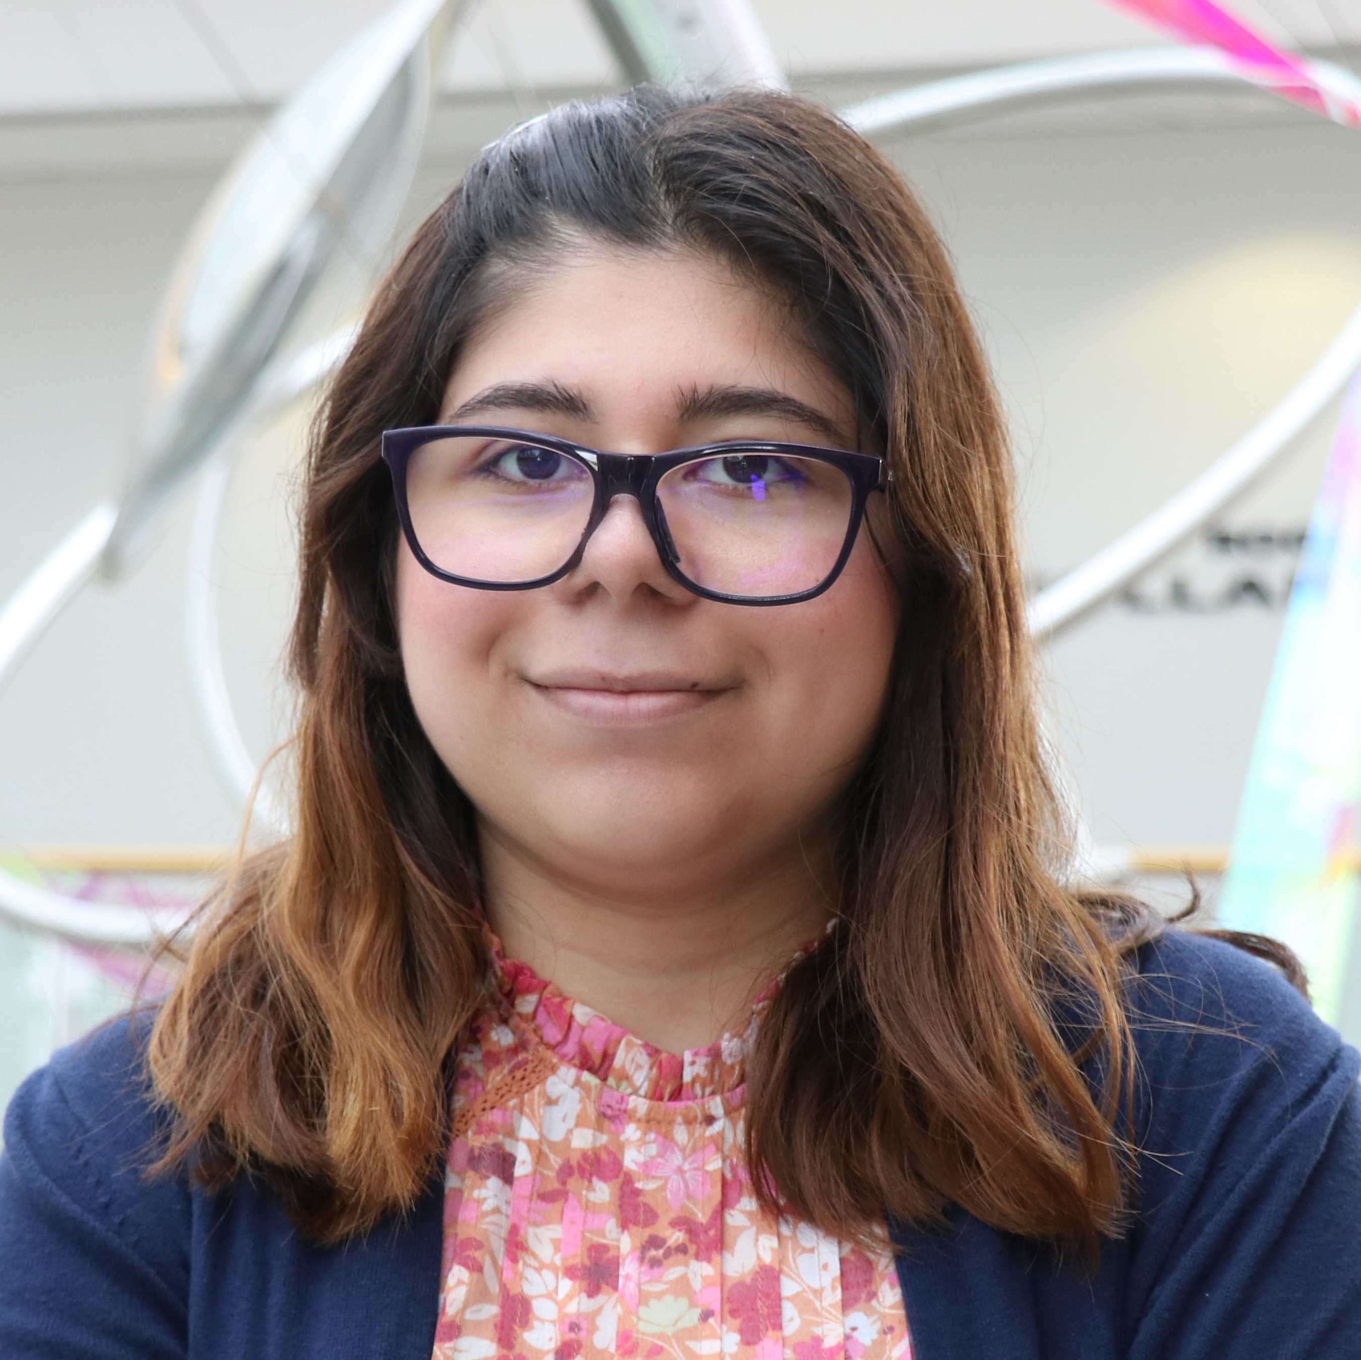
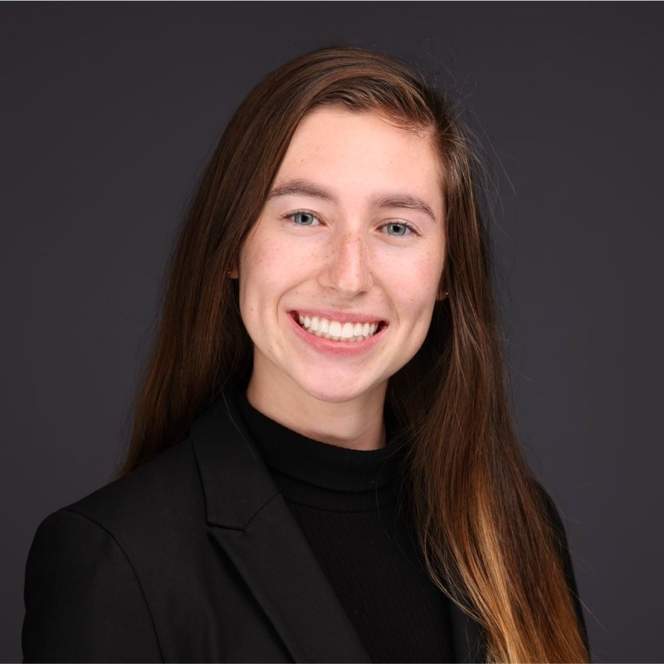
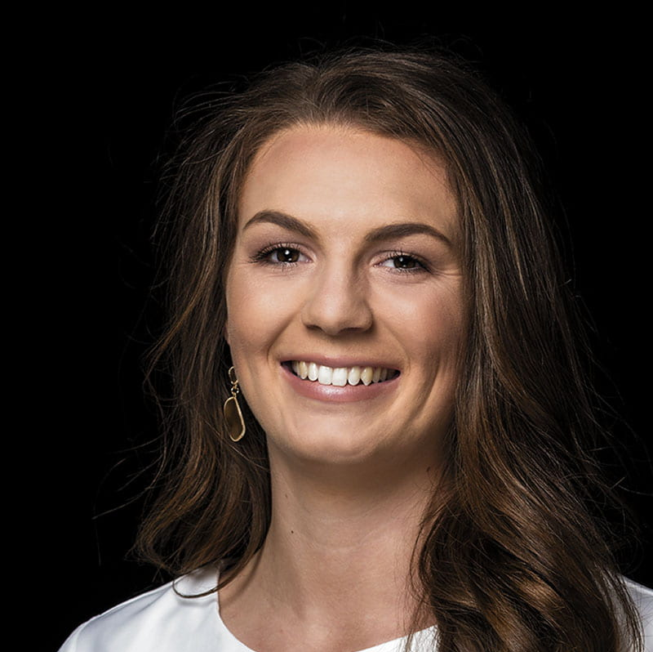
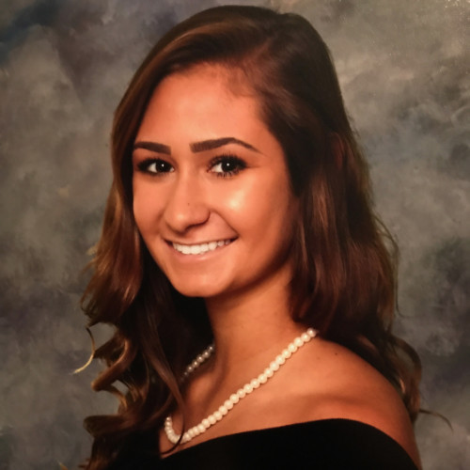
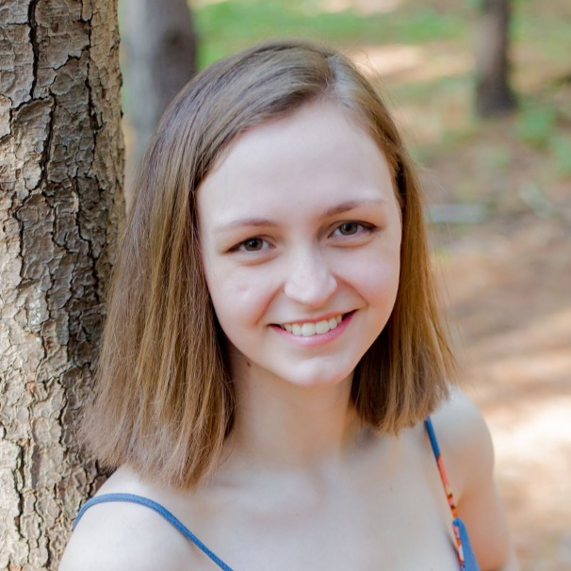
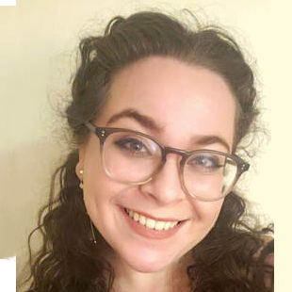
NSF Graduate Research Fellowship Program Honorable Mentions
Huda Ansaf Systems and Molecular Biology
Bacc. and Current Institution- MU
Summer Bjorn Geosciences
Bacc. and Current Institution- MU
Alyssa Labonte Neurosciences
Bacc. Institution- MU
Samantha Lapka Psychology
Bacc. Institution- MU
Allison Salamone Geosciences
Bacc. and Current Institution- MU
Alyssa Smolensky Computationally Intensive Research
Current Institution- MU
Elanor Jackson Computer Security
and Privacy
Bacc. and Current Institution- S&T
Megan Lenox Materials Engineering
Bacc. Institution- S&T

Slide 7
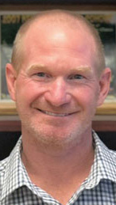
Faculty Success
Dr. Rachel Winograd
Clinical Psychology
Dr. Virginia Blanton, Humanities and Social Sciences Dr. Yotam Haber, Conservatory
Spoke at the National Governors Association in Washington D.C..
Named Fulbright Scholars for the 2023-24 academic year
Dr. Andy Frey
School of Social Work
Dr. Vadym Mochalin
Chemistry
Named Fellow of the American Academy of Social work and Social Welfare
Named a Fellow of the Royal Society of Chemistry

Slide 8
Total R&D Proposals (7/1-3/31)
Notes:
Data prepared by individual campuses and compiled by MU RII.
Updated 4/13/23

Slide 9
Total R&D Expenditures (7/1-3/31)
Notes:
Data prepared by individual campuses and compiled by MU RII.
Updated 4/13/23
Sponsored expenditures only

Slide 10
Federal R&D Proposals (7/1-3/31)
Notes:
Data prepared by individual campuses and compiled by MU RII.
4/13/23

Slide 11
Federal R&D Expenditures (7/1-3/31)
Notes:
Data prepared by individual campuses and compiled by MU RII.
4/13/23
Sponsored expenditures only

Slide 12
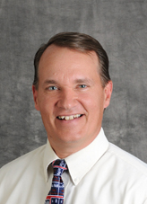
S&T Major Grant
Thermal Protection for Hypersonic Vehicles
PI: Dr. Gregory Hilmas, Materials Science & Engineering
Co-PIs: Drs. K. Chandrashekhara, Arezoo Emdadi, William Fahrenholtz, David Lipke and Jeremy Watts
$2.5M
Sponsor: General Electric
This collaboration between General Electric, Clemson University and Missouri S&T is the first phase of an innovative R&D project that advances development of hypersonics materials using advanced cooling technologies.
Hypersonic materials can be used for air/space travel and missiles ABMs.
Image Here

Slide 13
UMSL Major Grant
Bootheel Suicide Prevention Implementation Grant
PI: Katie Ellison, Missouri Institute of Mental Health Co-PI: Dr. Liz Sale, Missouri Institute of Mental Health
$1.0M
Sponsor: The Missouri Foundation for Health
To address the problem of suicide in Southeast Missouri, this project will tackle the stigma toward mental health, and the barriers for seeking help.
Project will engage employers and faith leaders in suicide prevention and lethal means reduction education and awareness-raising activities.
Image Here

Slide 14
UMKC Major Grant
Investigation of a newly identified group of neurons regulating sleep and feeding behaviors
PI: Dr. Stephane Dissel, Assistant Professor, Science and Engineering
$2.0M
Sponsor: NIH: Institute of Neurological Disorder
Animals (including humans) can decide to sleep or to skip sleeping entirely if their environment or other needs demand it.
This research will improve our understanding of how the brain makes key behavioral decisions that regulate sleep and feeding and the interactions.
Image Here

Slide 15
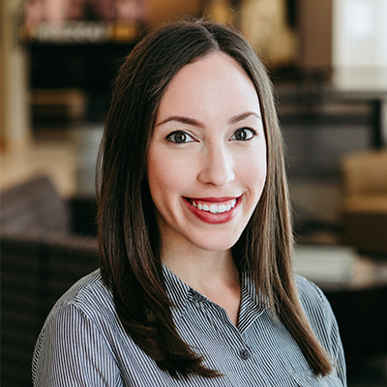
MU Major Grant
CAREER: Knowledge Exchange for Supporting Youth with or at Risk for Mathematics Difficulty
PI: Dr. Jessica Rodrigues, Assistant Professor of Special Education, College of Education and Human Development
$1.4M
Sponsor: National Science Foundation
This project will develop, assess and refine innovative concepts for improving mathematics education.
The project involves collaboration with the university disability center to provide STEM research opportunities to students with disabilities.
Image Here

Slide 16
Unique Opportunity for Mizzou to Save Lives

Slide 17
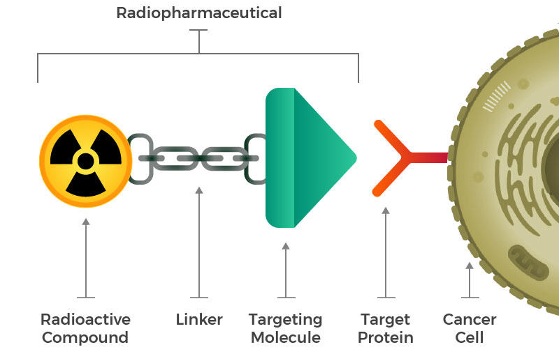
MU Nuclear Research Reactor

Slide 18
Efficacy of Targeted Radiopharmaceuticals
Prostate-Specific Membrane Antigen Positron Emission Tomography (PSMA PET) scan is an imaging test used to detect prostate cancer throughout the body
Meeting report from the Prostate Cancer Foundation PSMA theranostics state of the science meeting 2020
Andrea K. Miyahira PhD
PSMA levels before treatment
PSMA levels after treatment

Slide 19
November, 2022
Columbia, MO

Slide 20
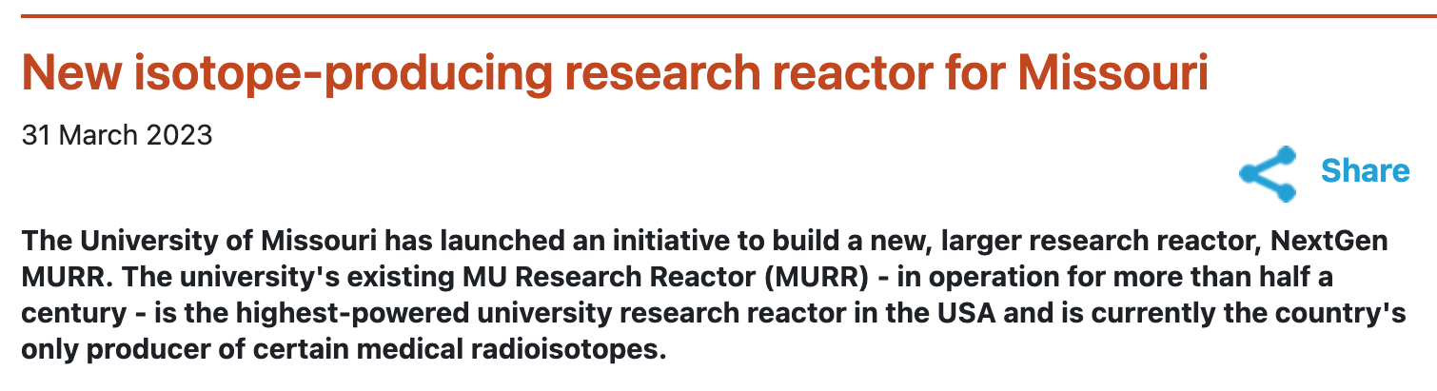
Current Reactor is 56 Years Old

Slide 21
NextGen MURR
New Breakthroughs Possible in Targeted Radiotherapy:
Gold-198 (Prostate Cancer)
Terbium-161 (Ovarian Cancer)
Rhenium-188 (Melanoma)
Rhenium-186 (Pancreatic & Breast Cancer)
Arsenic-77 (Prostate Cancer)
Targeted Alpha Imaging & Therapy
We can’t outsource radioisotope production
Short half life
Healthcare for Americans must not be determined by supply chain or geopolitical issues
NextGen MURR is essential for MO and the US
NextGen MURR will require ~$1B to construct and will require 8 to 10 years
Missouri can be the epicenter for nuclear medicine to attract researchers, pharmaceutical firms, investors and distribution centers
Notes:
Collaboration for human trials to commercialize and bring to patients (mention, update slide?)
Simply put, we are out of space and we need to build the case for the new reactor
The ONLY, unique capabilities --> if we stop the reactor, isotope production stops
This is more than a building, we are investing in a team of 250 world experts
MURR is licensed thru 2037, but it becomes harder to maintain as it ages. This is a proactive step.
Twice as powerful with new one, we can make isotopes we can't make now.
This is securing the next 50 years of excellence at Mizzou.
Ideally keep the old one running, too.

Slide 22
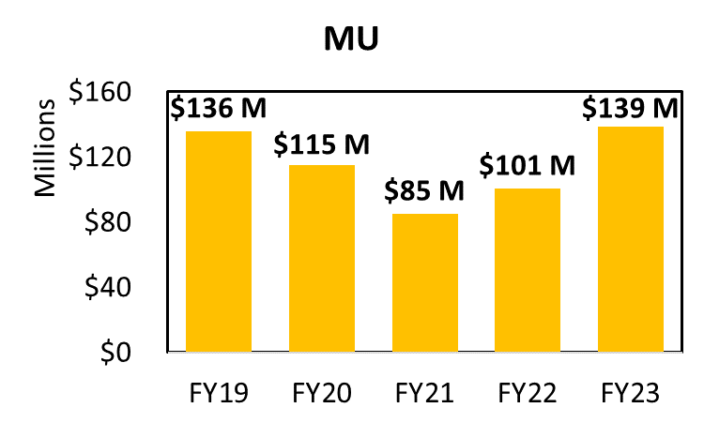
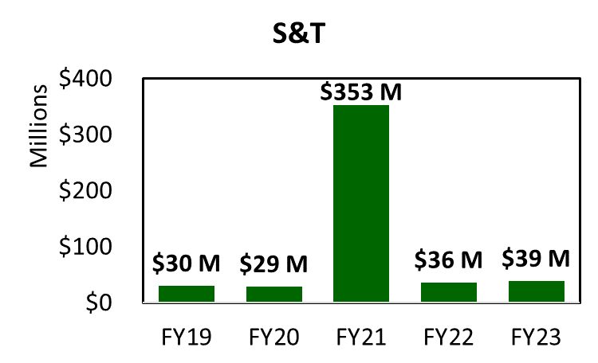
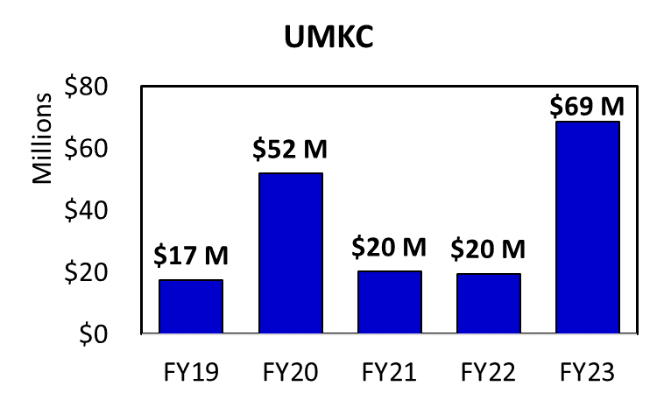
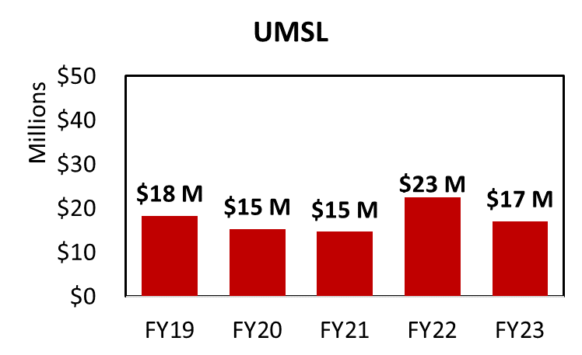
Philanthropy (7/1/22-3/31/23)
Notes:
Waiting on UMSL to verify 2019 and 2020 data.

Slide 23
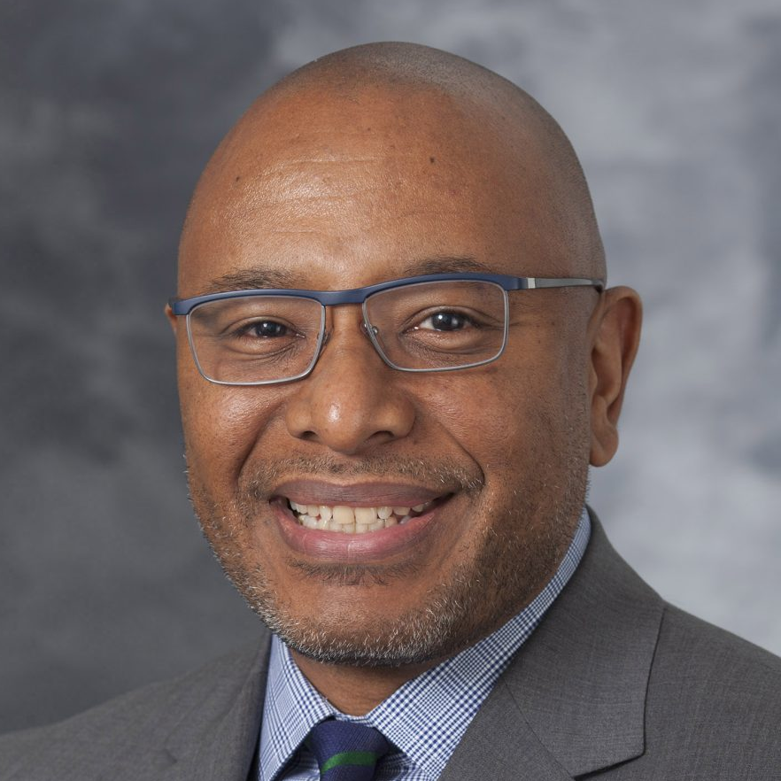
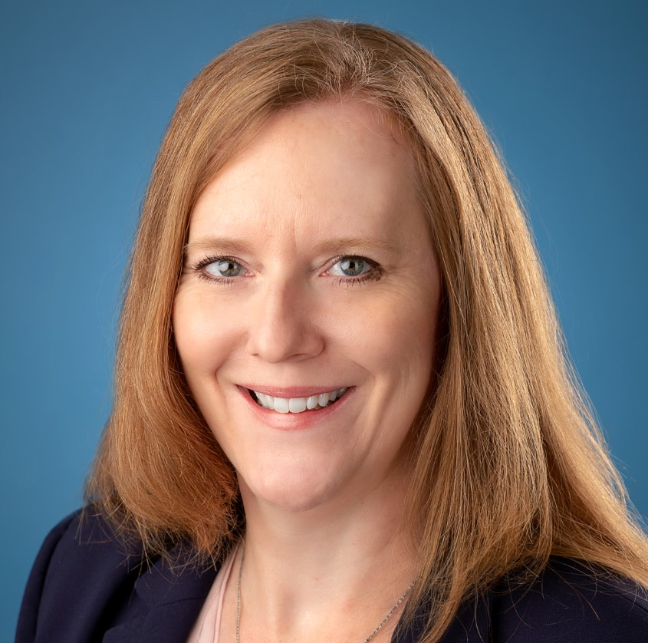
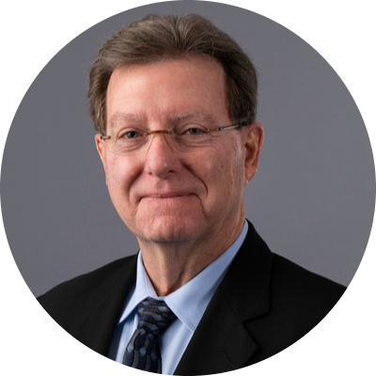
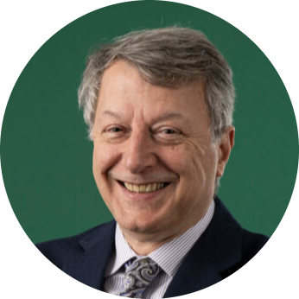
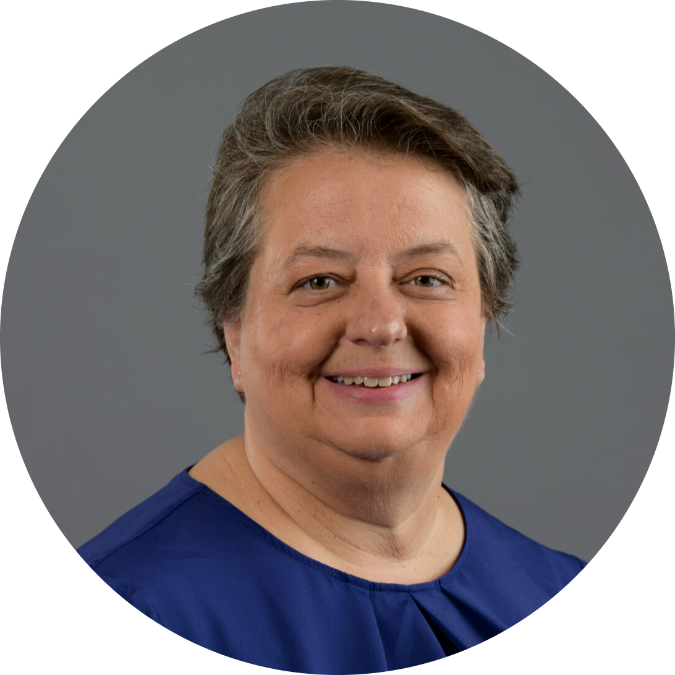
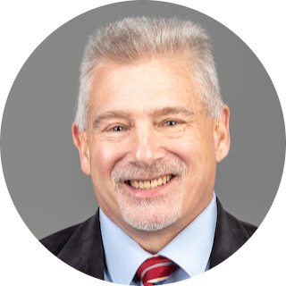
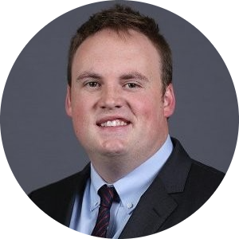
UM Leadership Appointments
Ric Ransom,
Chief Executive Officer
of MU Health Care
Cheryl Cain,
Vice Chancellor of Marketing and Communications and Chief Marketing and Communications Officer
Timothy Faley,
Interim Vice Provost and Dean of Kummer College of Innovation, Entrepreneurship, and Economic Development
Kamal Khayat,
Vice Chancellor of Research & Innovation
Susan Murray,
Interim Vice Provost of
Online Education
Stephen Raper,
Associate Provost for Academic Operations, Accreditation and Assessment
Fred Stone,
Associate Vice Chancellor of Facility Planning and Operations

Slide 25
Federal R&D Proposals (7/1-3/31)
Notes:
Data prepared by individual campuses and compiled by MU RII.
4/13/23

Slide 26
Federal R&D Expenditures (7/1-3/31)
Notes:
Data prepared by individual campuses and compiled by MU RII.
4/13/23
Sponsored expenditures only

